Slide 1
Evaluation Demonstration for “Evaluating the Use of Sound to Help Representation of Distance in a Landscape Visualisation Setting” by Nick Bearman & Andrew Lovett
These slides demonstrate the sonification technique used in this evaluation.
See associated GISRUK 2012 paper for details.

Slide 2
A series of landscape visualisations are shown, with the distances of the turbines represented using sound in some of the examples.
After each visualisation, participants would be asked to estimate how many turbines are within 2000m (i.e. closer to the user than 2000m).
Click to continue.

Slide 3
Vision Only
In the next slide, the turbines are shown visually only. There is no sound.
Each turbine is highlighted in turn, with a 2 second gap between each turbine.
Click to continue.

Slide 4
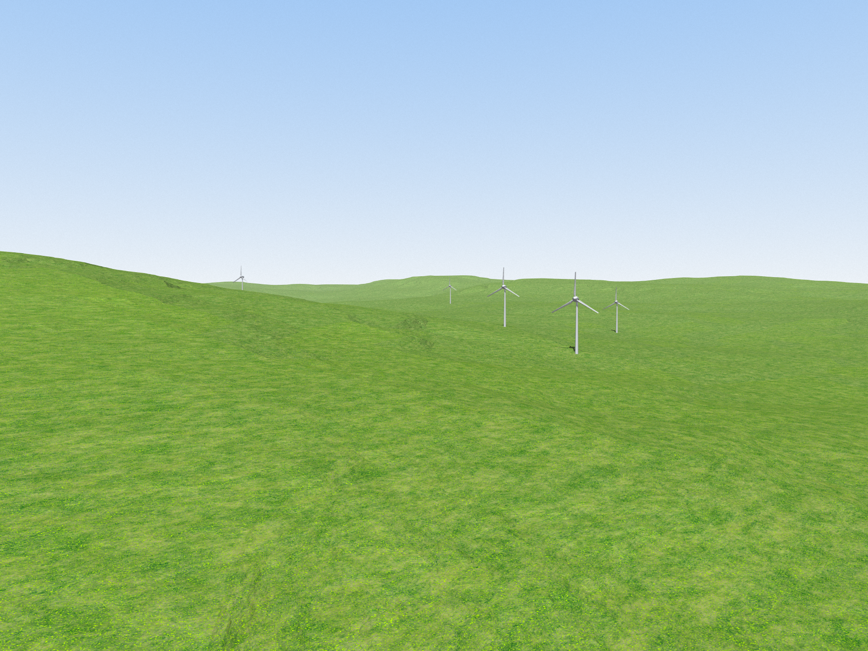

Slide 5
Vision & Sound (Piano)
The next slide uses vision and piano notes to represent the distance of the turbines.
The sounds are 9 different piano notes. (click to play)
The piano notes get lower for greater distances
For example (click to play)
1000m
3000m
Click to show the turbines

Slide 6
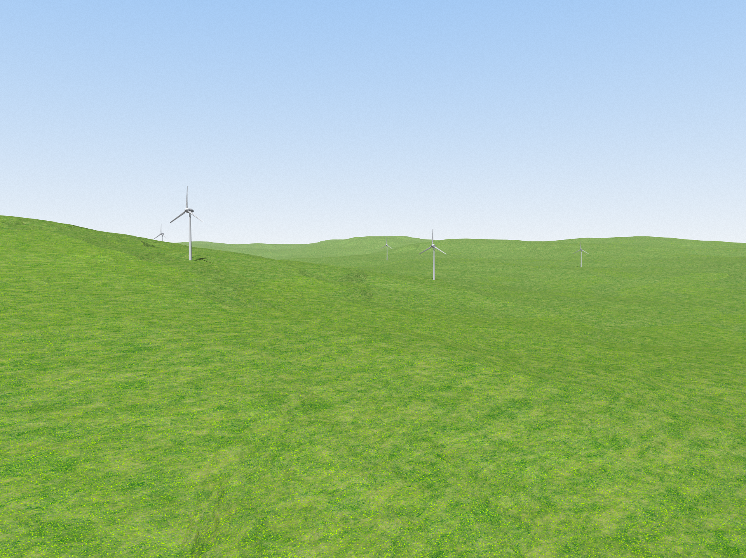

Slide 7
Sound Only (Piano)
The next slide uses just sound to represent the distance of the turbines.
There is no visual element – a blank screen will be shown.
The sounds are the same as used before.
For example
1000m
3000m
Click to play the turbines

Slide 9
Vision & Sound (Bird Call)
The next slide uses vision and bird call notes to represent the distance of the turbines.
The sounds are 9 different bird calls. (click to play)
The bird calls get lower for greater distances
For example (click to play)
1000m
3000m
Click to show the turbines

Slide 10
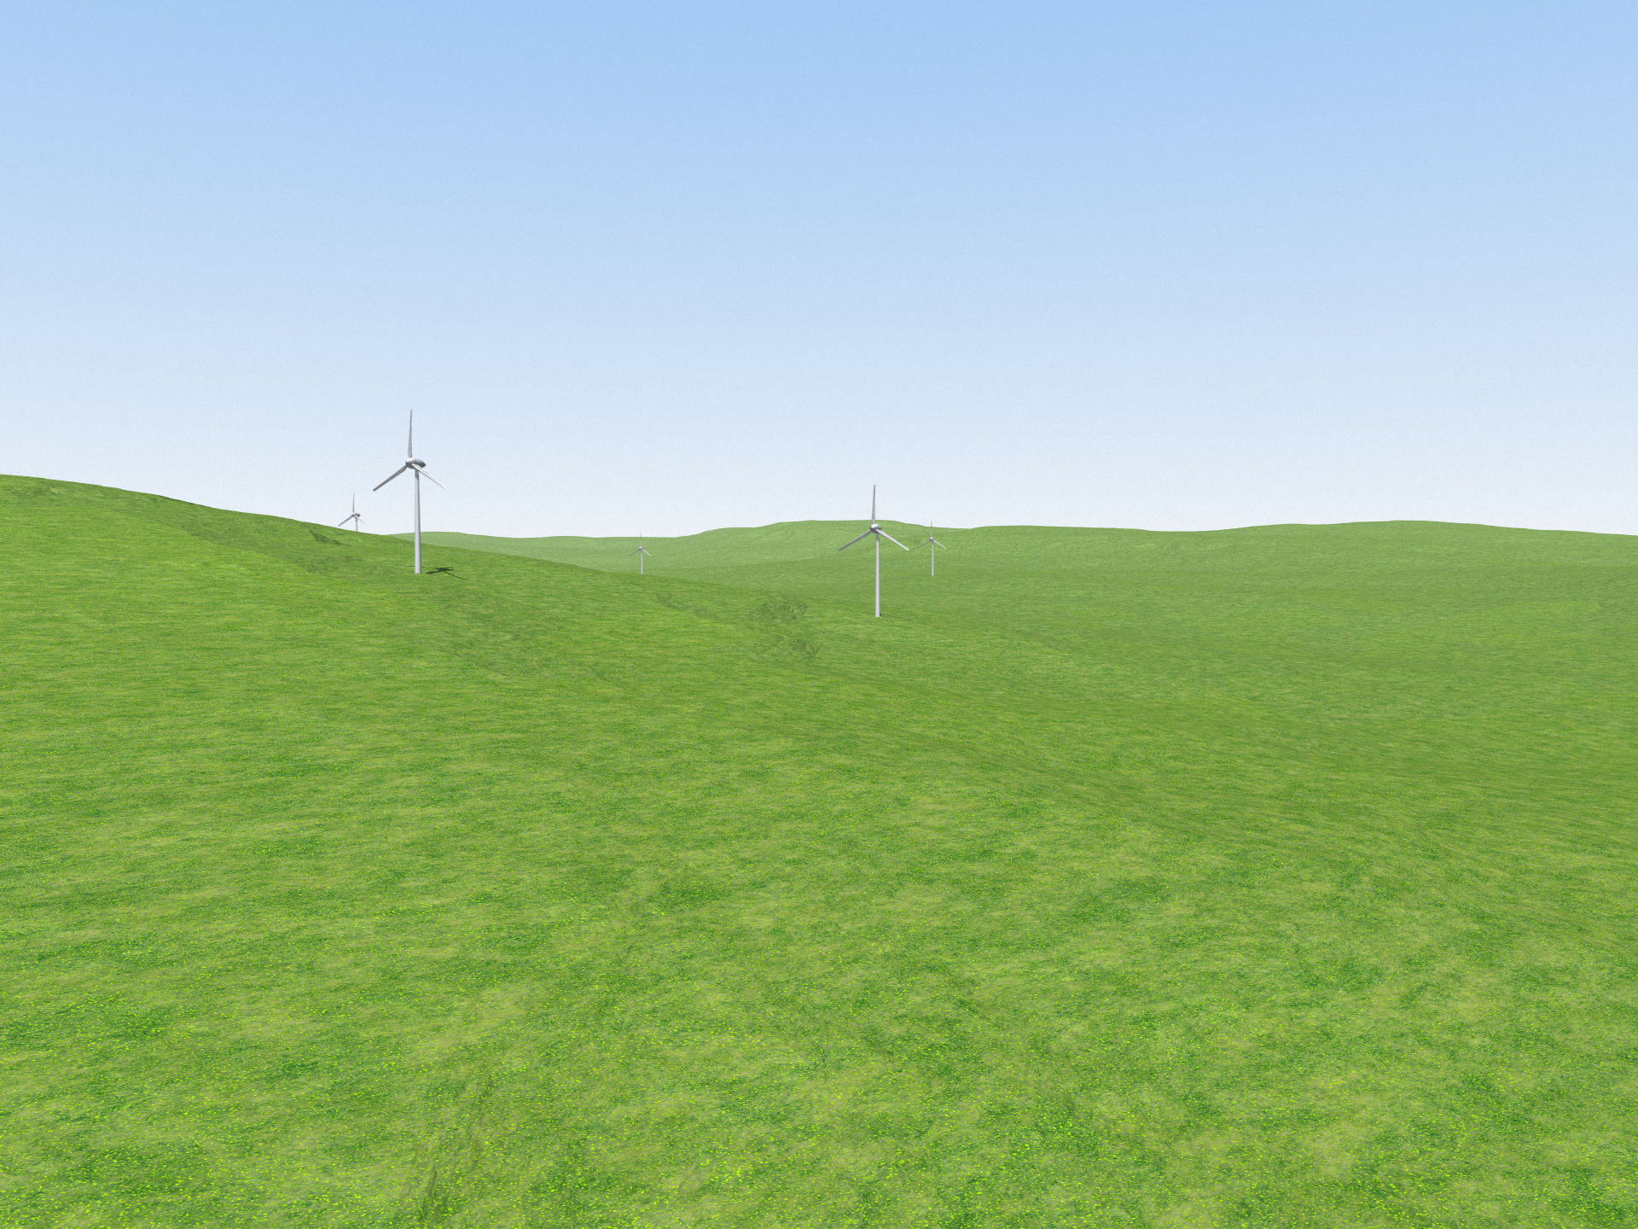

Slide 11
Sound Only (Bird Call)
The next slide uses just sound to represent the distance of the turbines.
There is no visual element – a blank screen will be shown.
The sounds are the same as used before.
For example
1000m
3000m
Click to play the turbines

Slide 12
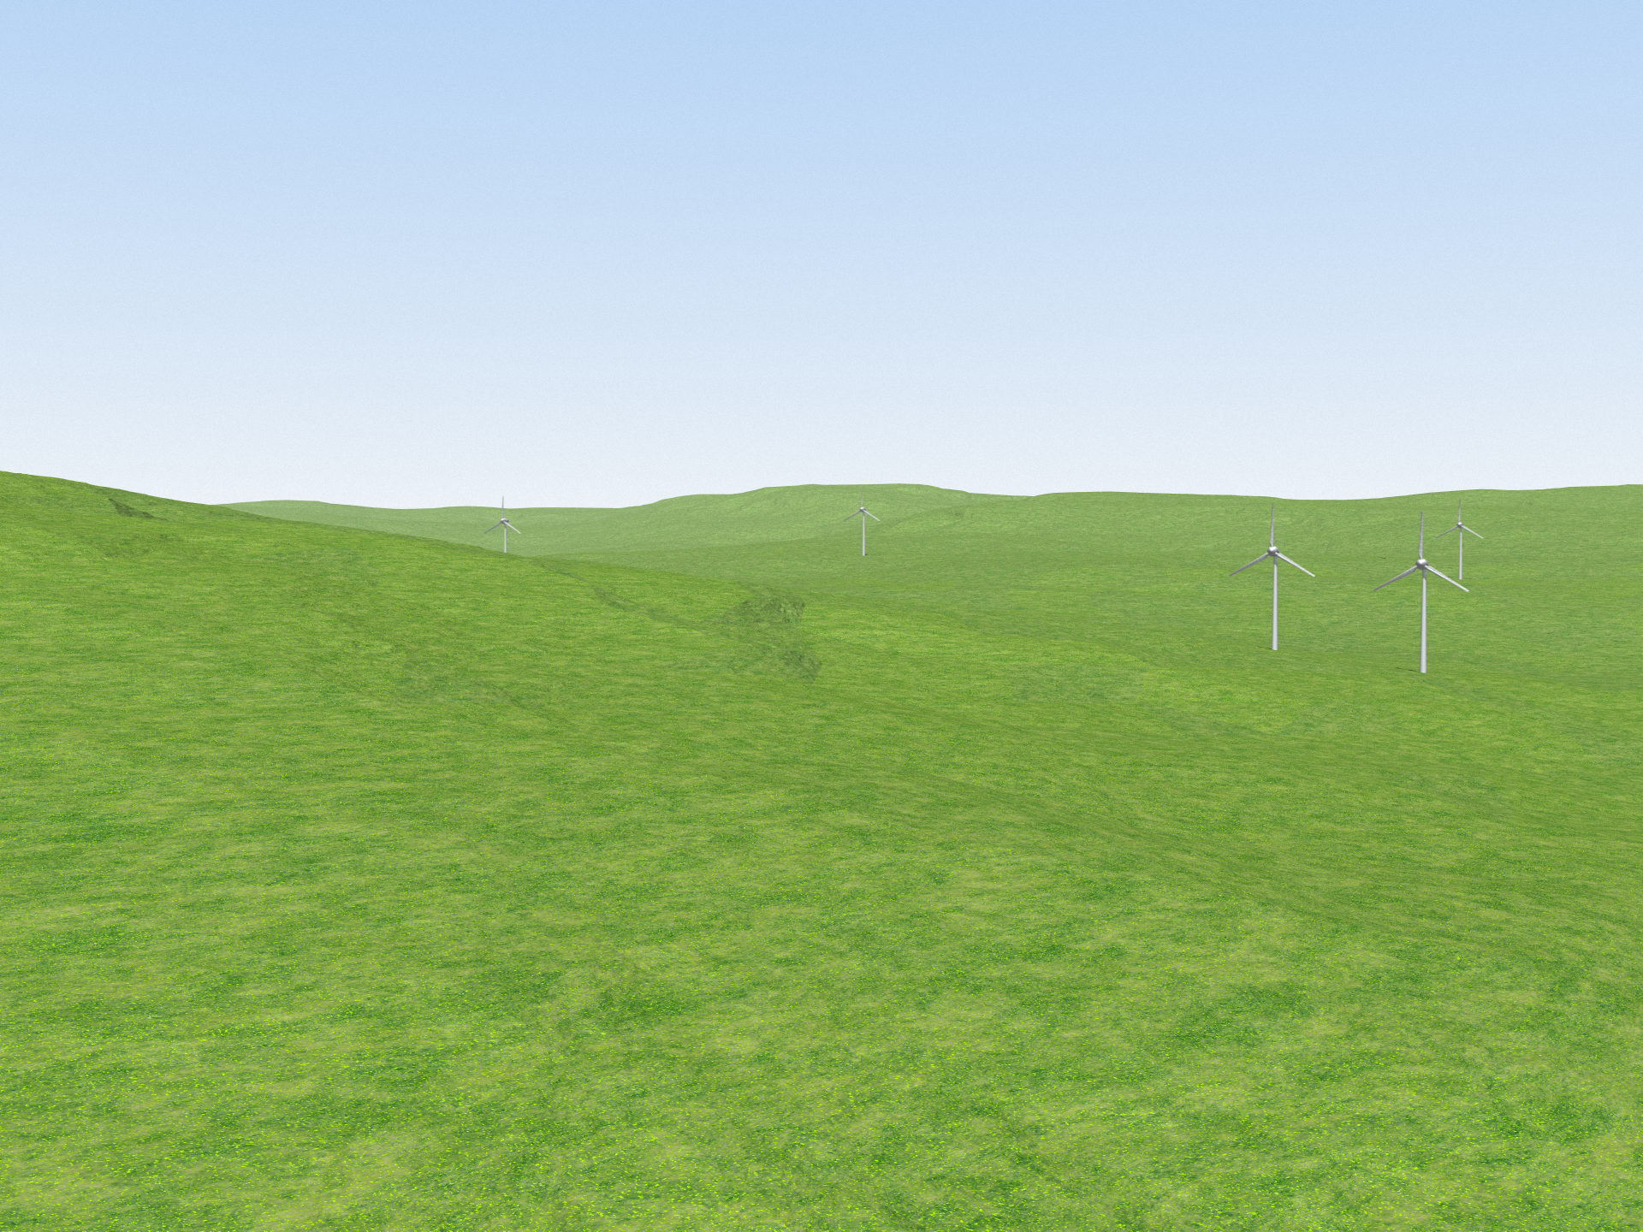

Slide 13
Vision with Scale
The next slide shows the wind turbines visually, with no sound element.
The turbine at a distance of 1000m is highlighted, and the distance labelled on the visualisation.
Click to show the turbines.

Slide 14

1000m

